Slide 1
DATA ANALYST
Task
Presentation
By :
Medipally Shruthi
Data Analyst
September G2

Slide 2
CONTENTS
1. ACKNOWLEDGEMENT
2. BEGINNER LEVEL
3. INTERMEDIATE LEVEL
4. ADVANCED LEVEL
5. KEY BUSINESS INSIGHTS
6. CONCLUSION

Slide 3
ACKNOWLEDGEMENT
I would like to express my gratitude to ShadowFox for providing me with the opportunity to work on Data Analyst internship tasks.
I am thankful for the guidance and learning resources provided throughout the internship.
This presentation summarizes the work completed/prepared across the Beginner, Intermediate and Advanced levels of the Data Analyst track.

Slide 4
BEGINNER LEVEL
Task:Comprehensive Sales Data Analysis and Visualization using Excel
Selected and organized a structured sales dataset.
Cleaned and prepared the data for analysis.
Calculated key summary metrics.
Analyzed monthly sales trends.
Analyzed product and category performance.
Compared regional sales performance.
Created charts and a dashboard-style summary.
Identified important business observations.

Slide 5
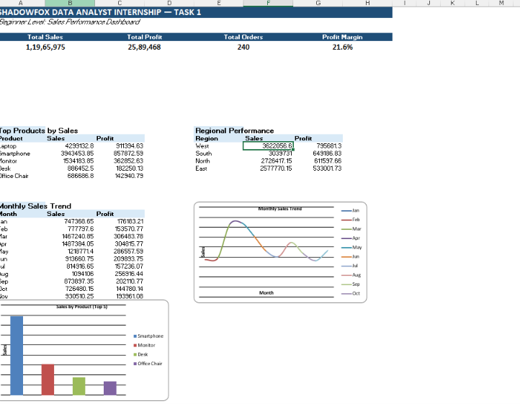
1. Key Metrics / Summary Dashboard
Description:
A summary view presenting the major sales performance indicators such as total sales, total profit, orders, and other important business metrics.
Use Case:
Helps quickly understand the overall business performance and identify important performance indicators.

Slide 6
2. Monthly Sales Trend
Description:
A line chart showing how sales performance changes across different months.
Use Case:
Helps identify sales trends, high-performing months, low-performing periods, and changes in business performance over time.

Slide 7
3. Product-wise Sales Analysis
Description:
A bar chart comparing sales performance across different products.
Use Case:
Helps identify high-performing and low-performing products and supports product-level business decisions.

Slide 8
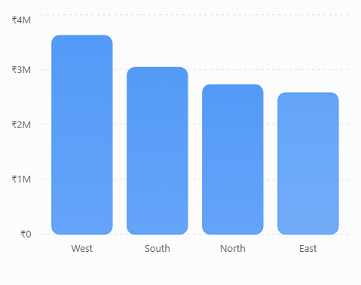
4.Regional Sales Analysis
Description:
A visualization comparing sales performance across different geographical regions.
Use Case:
Helps identify stronger and weaker regions and supports regional sales planning and resource allocation.

Slide 9
INTERMEDIATE LEVEL
Task: Exploratory Business Analysis and Performance Insights
Performed exploratory analysis on the prepared sales dataset.
Analyzed customer purchase behaviour and repeat activity.
Analyzed product and category performance.
Compared regional sales performance.
Identified monthly sales trends and variations.
Created visual reports to present analytical findings.
Identified important business insights from the analysis.
Suggested practical recommendations based on the findings.

Slide 10
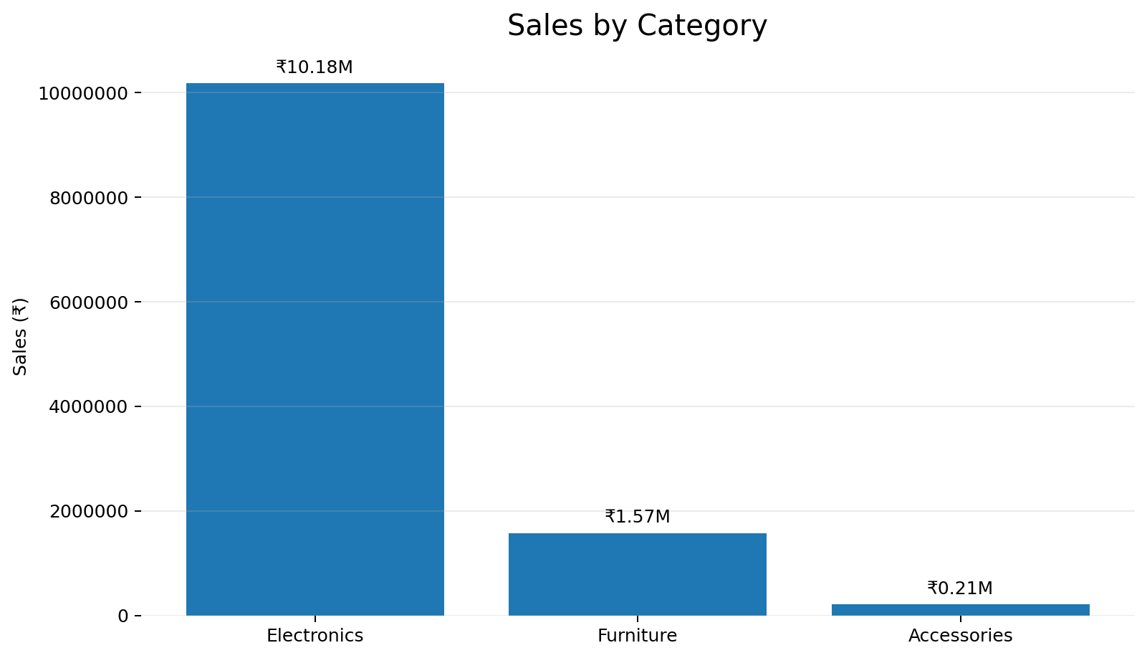
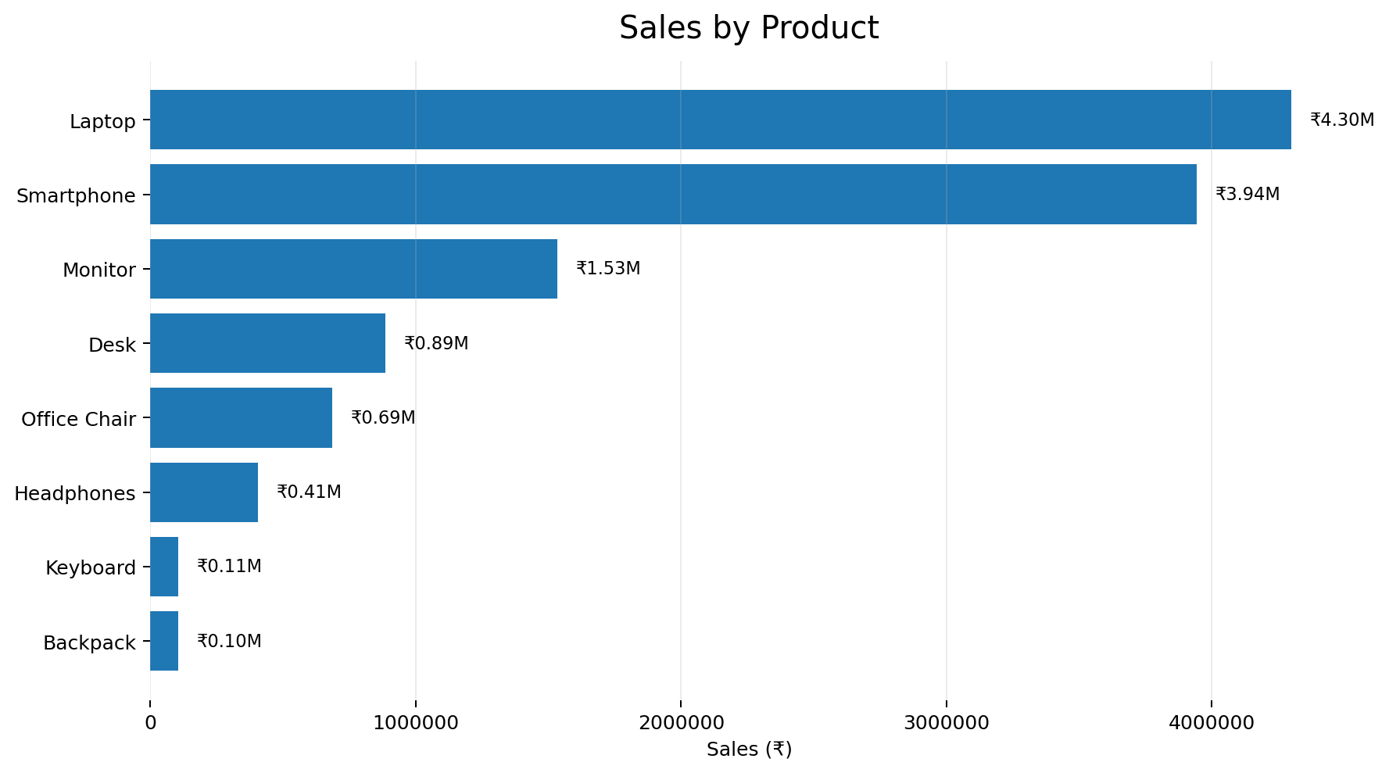
Product & Category
Identified top-performing products and categories based on sales contribution.

Slide 11
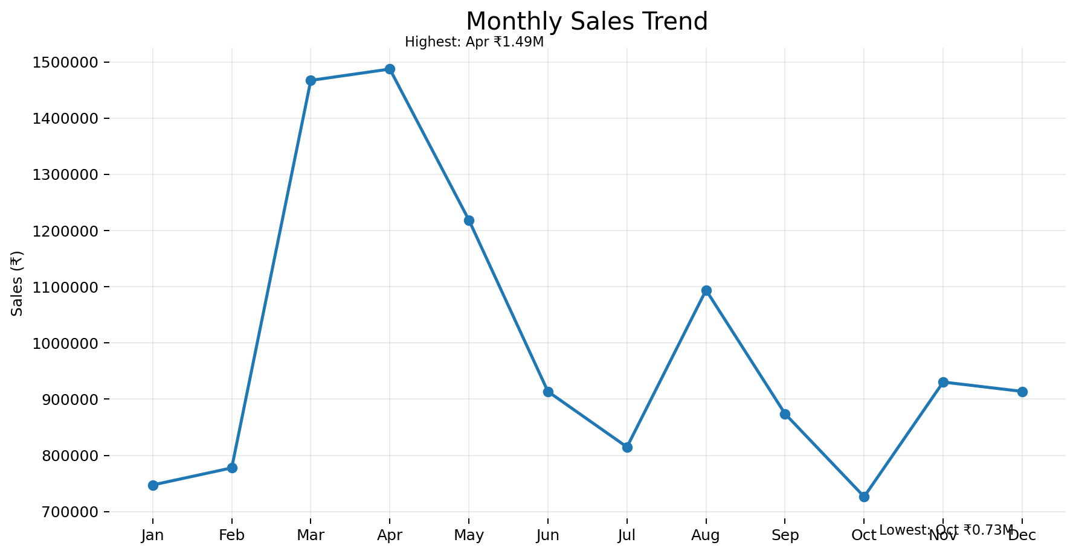
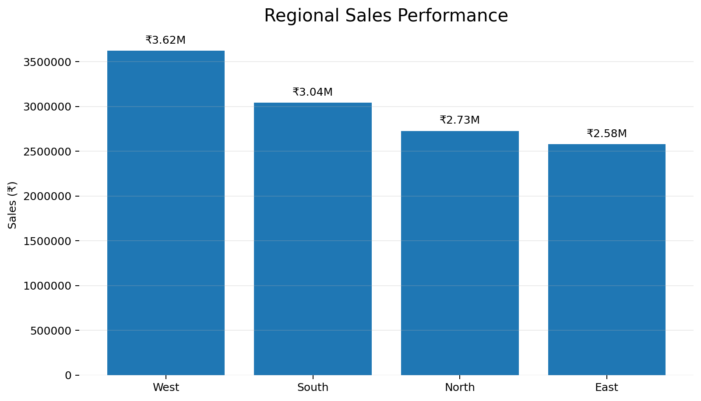
Regional & Monthly Analysis
Analyzed sales performance across regions and monthly trends to identify high- and low-performing periods.

Slide 12
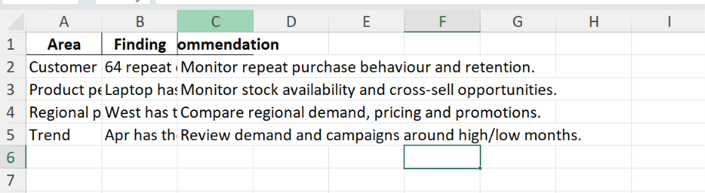
Business Insights & Recommendations
Identified key business patterns and suggested practical actions for improvement.

Slide 13
ADVANCED LEVEL
Task: Executive Sales Dashboard and Business Performance Reporting
Prepared and transformed the sales data for dashboard development.
Selected key KPIs for executive-level performance tracking.
Designed an executive-style dashboard using Power BI/Tableau.
Created interactive visuals for sales and business performance.
Added filters and interactive reporting elements.
Presented key business insights through visual storytelling.
Analyzed sales, product, category, and regional performance.
Provided decision-oriented recommendations based on the dashboard findings.

Slide 14
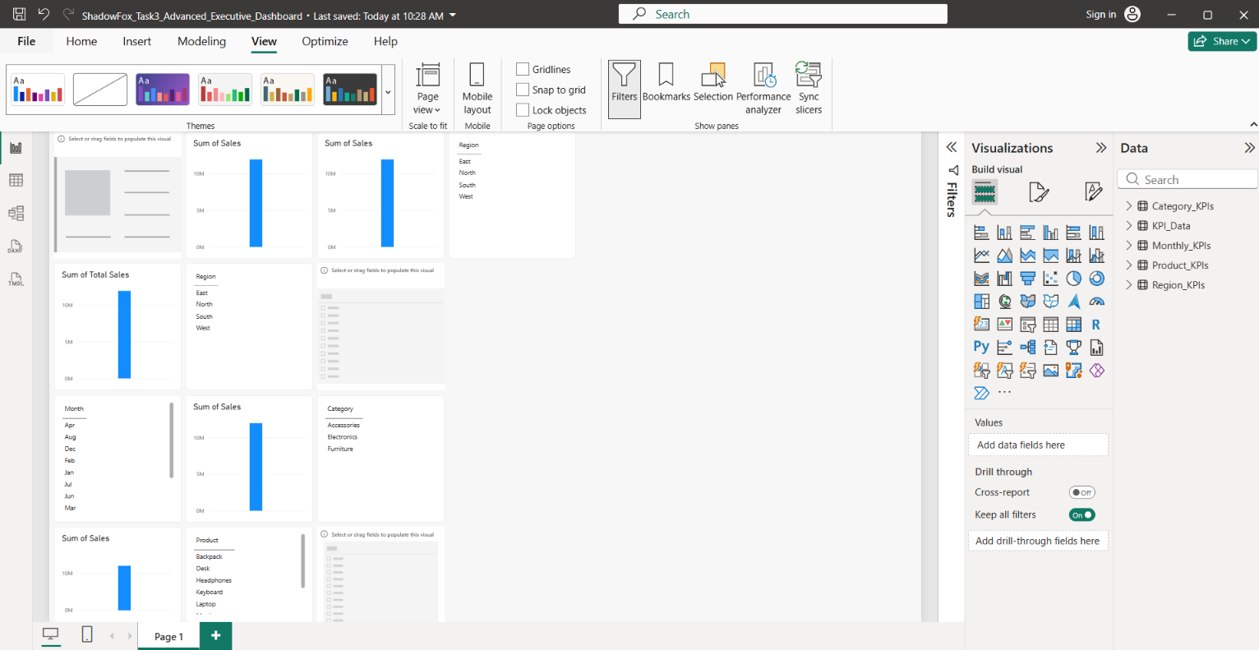
Executive Dashboard & KPI Design
Description: Designed an executive Power BI dashboard to track key business performance indicators and sales trends.
Use Case: Helps decision-makers quickly monitor performance and identify important business trends.

Slide 15
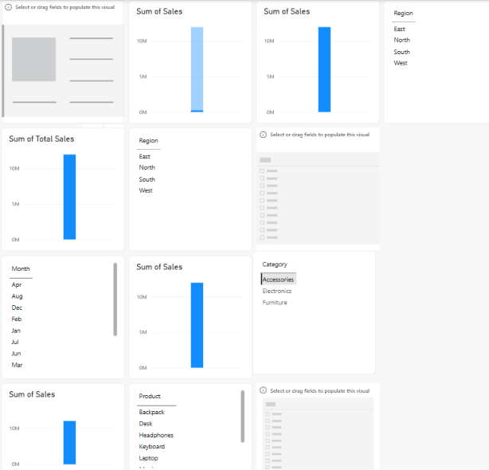
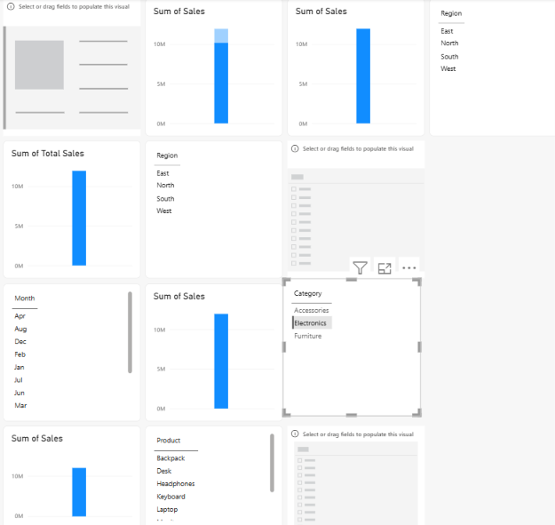
Key Business Insights
Description: Identified key patterns and performance trends from the sales analysis.
Use Case: Helps understand business performance and support data-driven decisions.

Slide 16
Recommendations & Conclusion
Description: Summarized the findings and proposed practical actions for business improvement.
Use Case: Helps convert analytical findings into actionable business decisions.
Customer Behaviour: Monitor repeat purchases and strengthen customer retention.
Product Performance: Maintain Laptop stock and explore cross-selling opportunities.
Regional Performance: Compare regional demand, pricing and promotional strategies.
Monthly Trends: Review high- and low-performing months to improve planning.
Overall Performance: Use KPI dashboards regularly to support data-driven decisions.

Slide 17
THANK YOU

